Slide 1
Course Title: Introduction to Data Science Course Code: UE18CS203 OSMI Mental Health in Tech Survey 2016
Done By: Mahah (PES1201801529)
Pranav ( PES1201800288)
Vibha (PES1201800158)

Slide 2
What is Mental Health?
Mental health includes our emotional, psychological, and social well-being. It affects how we think, feel, and act. It also helps determine how we handle stress, relate to others, and make choices.
Mental health is important at every stage of life, from childhood and adolescence through adulthood.
Work is good for mental health but a negative working environment can lead to physical and mental health problems.
Depression and anxiety have a significant economic impact; the estimated cost to the global economy is US$ 1 trillion per year in lost productivity. ( According to World Health Organization, May 2019

Slide 3

Mental Health and the Tech Industry

Slide 4

Mental Health and the Tech Industry
Over 52% of tech workers have suffered from anxiety or depression at some point ?!
Does that mean I’m depressed?

Slide 5
What we intend to do with the data
The ongoing 2016 survey aims to measure attitudes towards mental health in the tech workplace, and examine the frequency of mental health disorders among tech workers.
We are interested in gauging how mental health is viewed within the tech/IT workplace, and the prevalence of certain mental health disorders within the tech industry.
The Open Sourcing Mental Illness team of volunteers will use this data to drive work in raising awareness and improving conditions for those with mental health disorders in the IT workplace.

Slide 6
What we intend to do with the data
We want to gain useful insights as to what factors are affecting employees mental health in the IT workplace, and to see if these conditions can be improved to better increase workplace productivity and employees mental health

Slide 7
Onto data Analysis,
but first let’s do some data cleaning

Slide 8
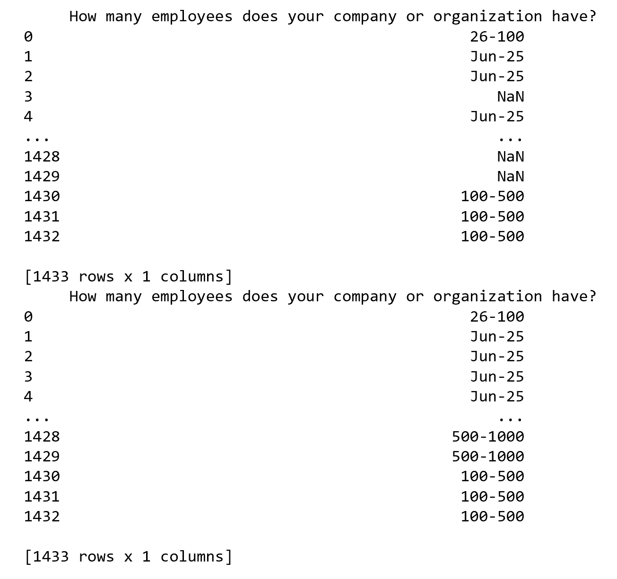
Data Cleaning
All NAN’s for categorical columns to be replaced with previous values

Slide 9
Data Cleaning
NAN’s of categorical columns replaced with succeeding values
This was done as some of the initial values were NAN’s and replacing with previous values did not affect the dataset

Slide 10
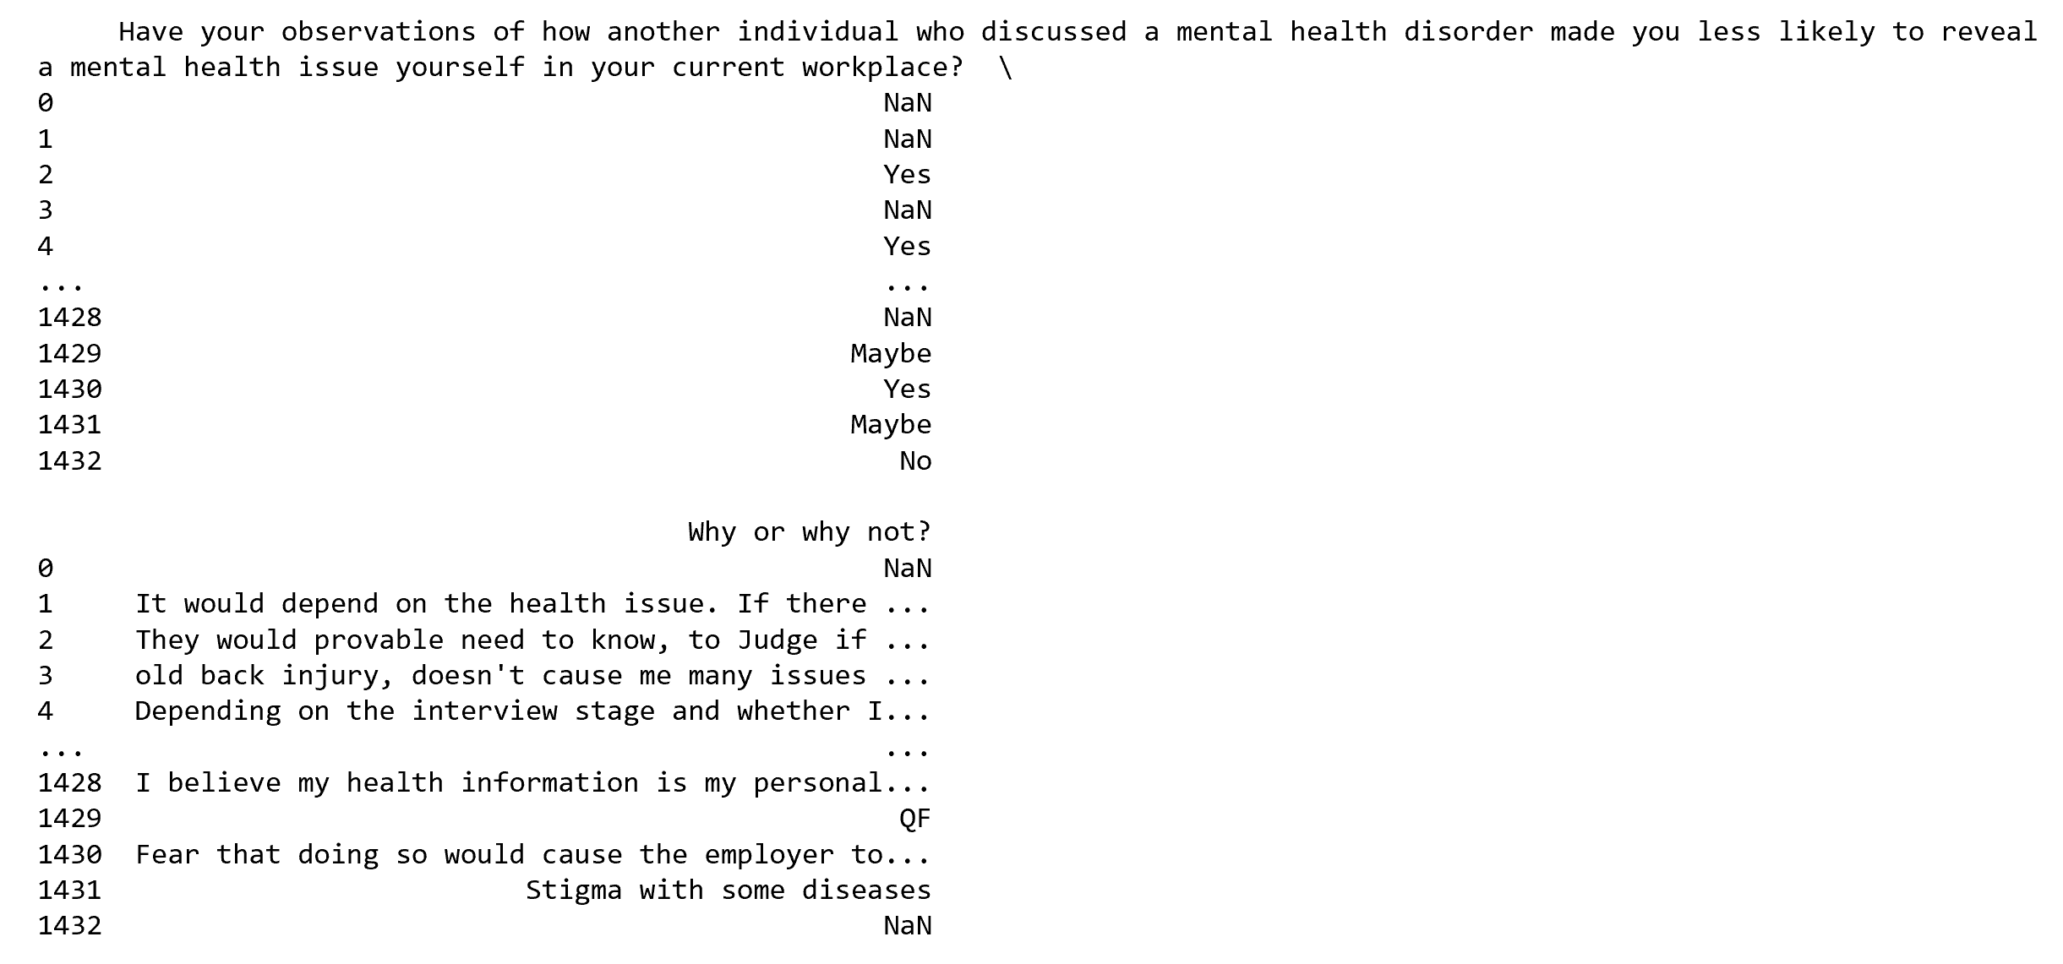
Before Cleaning

Slide 11
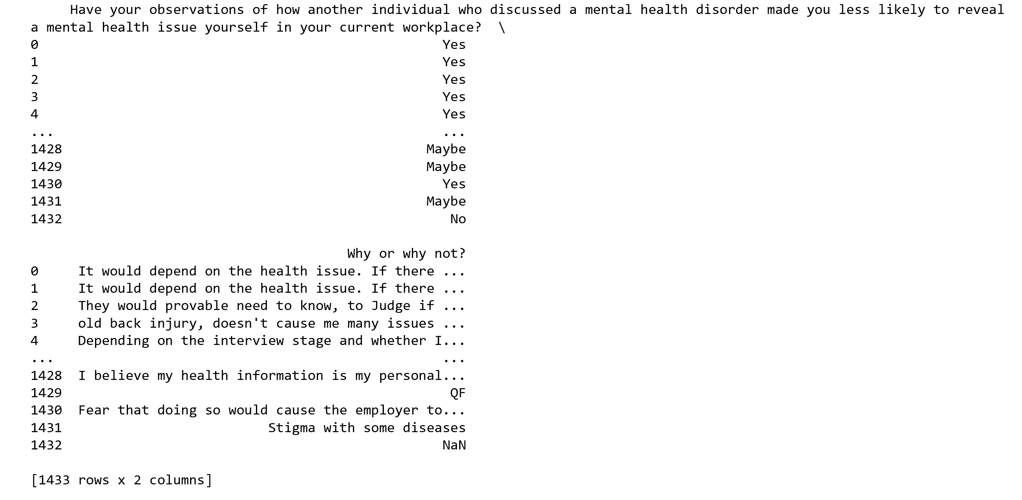
After Cleaning

Slide 12
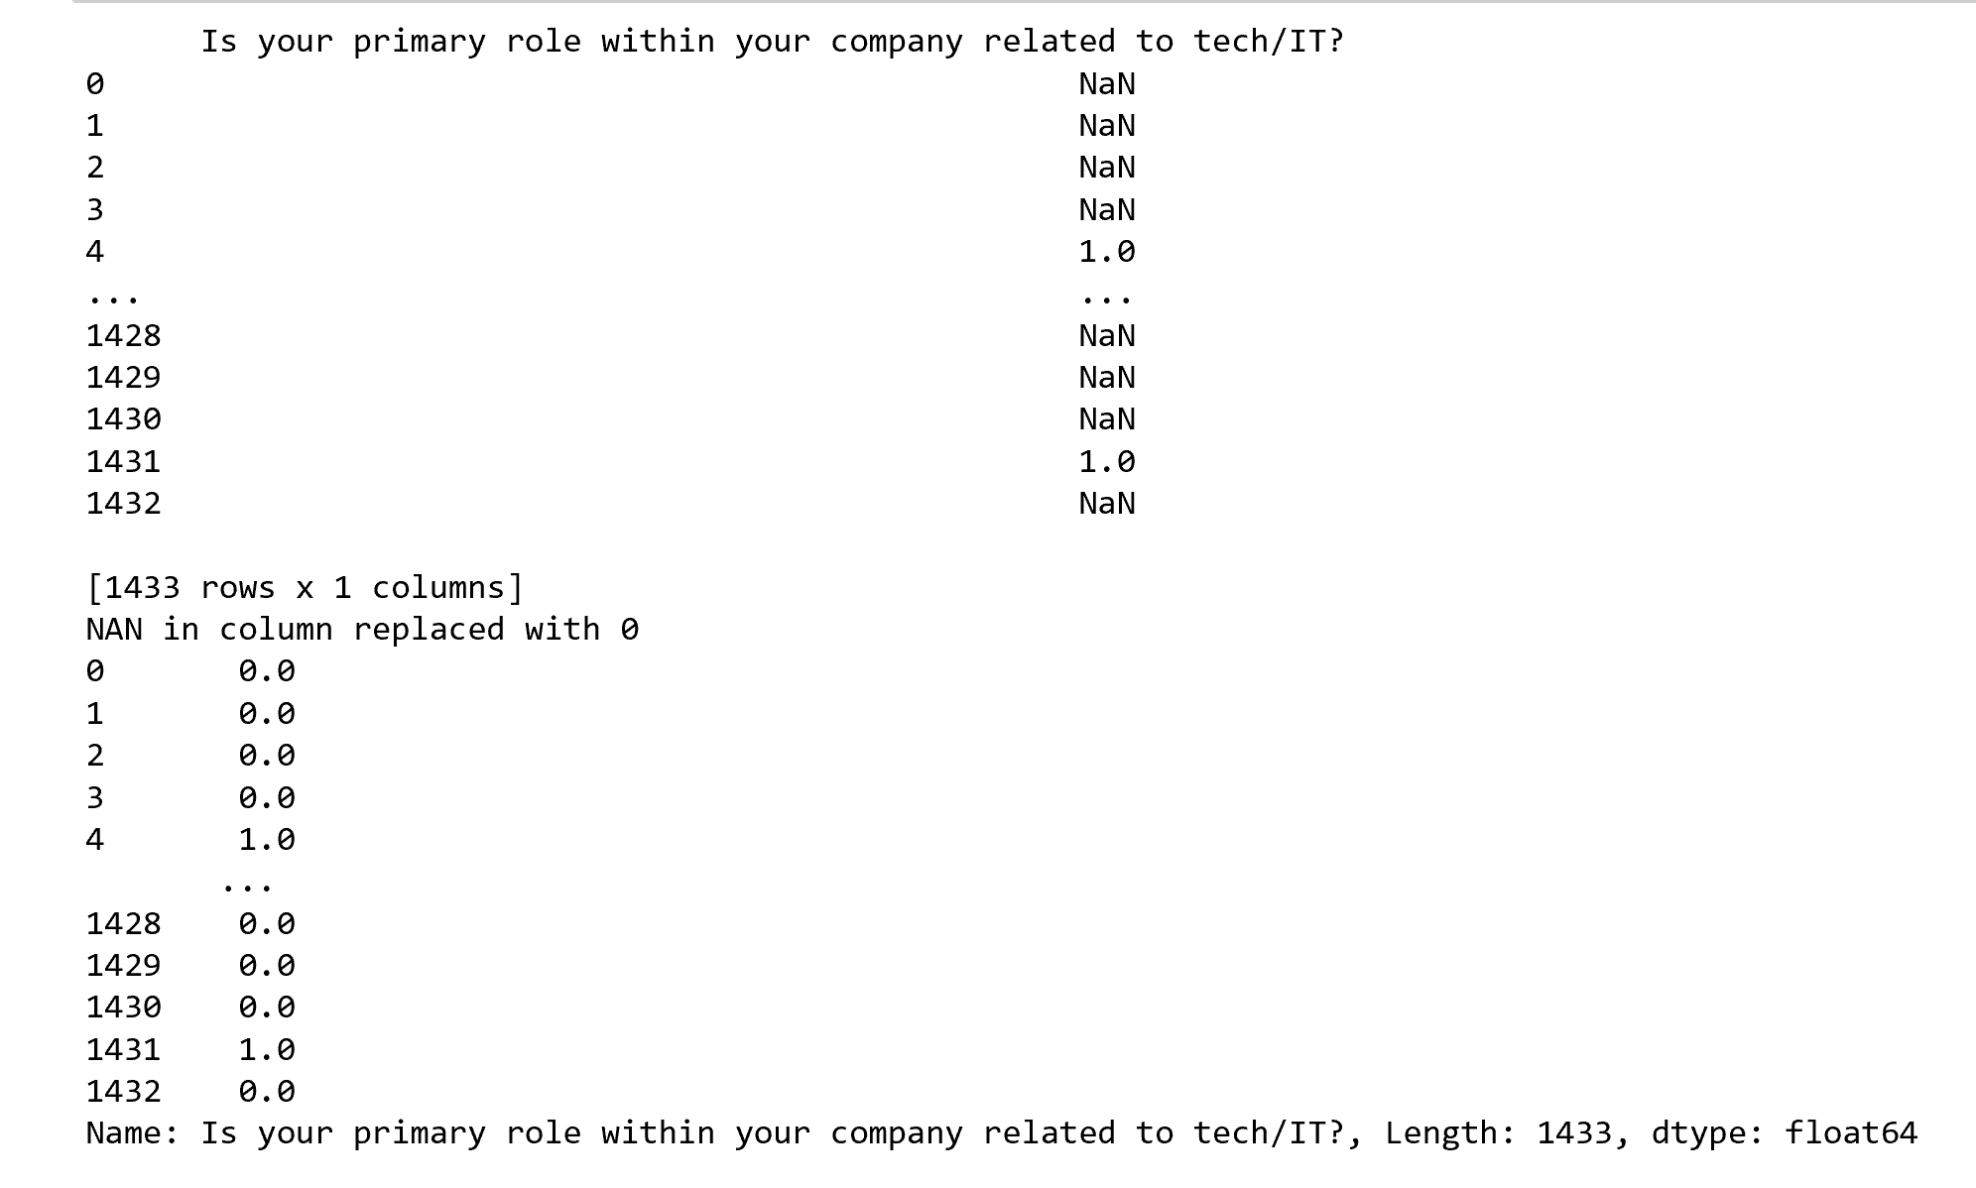
Data Cleaning
Replacing NAN values with zeroes

Slide 13
Data Cleaning
Numeric columns present in the dataset such as Age do not have NAN values hence no cleaning was required for the numeric columns.
For the same reason interpolation of data for the numeric columns was not done.

Slide 14
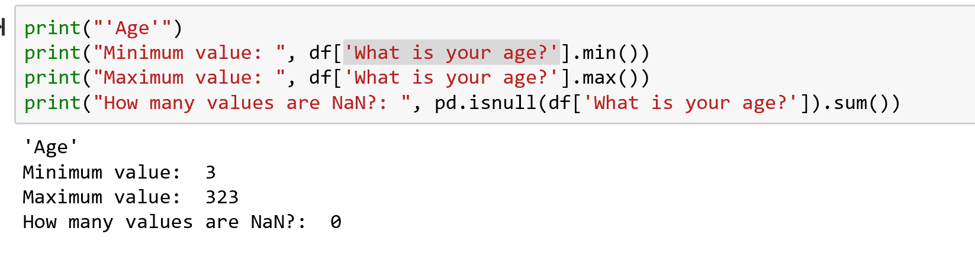
Data Cleaning
Remove Age outliers
For the purpose of this analysis, we will simply replace any out-of-range age values with "NaN", rather than delete the rows from the data set.
Before Cleaning:

Slide 15
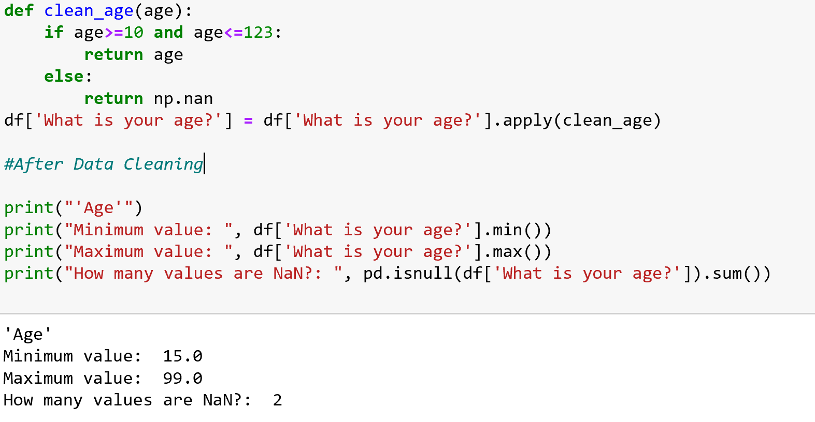
Data Cleaning
After Cleaning:

Slide 16
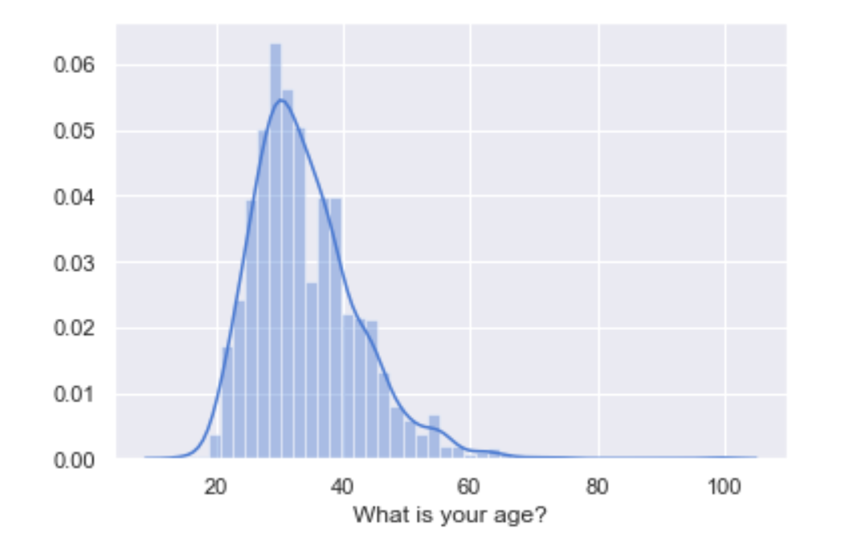
Data Cleaning
Distribution of ages after Cleaning

Slide 17
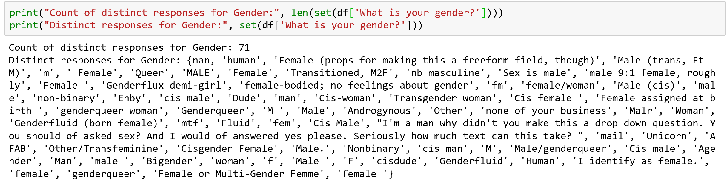
Data Cleaning
Standardize gender into categories
Upon analysis we found that there were 71 unique responses for gender

Slide 18
Data Cleaning
We have decided to consolidate the gender variable into the following categories, given the nature and quantities of the open-ended responses.
Male (cis)
Male (trans)
Female (cis)
Female (trans)
Other

Slide 19
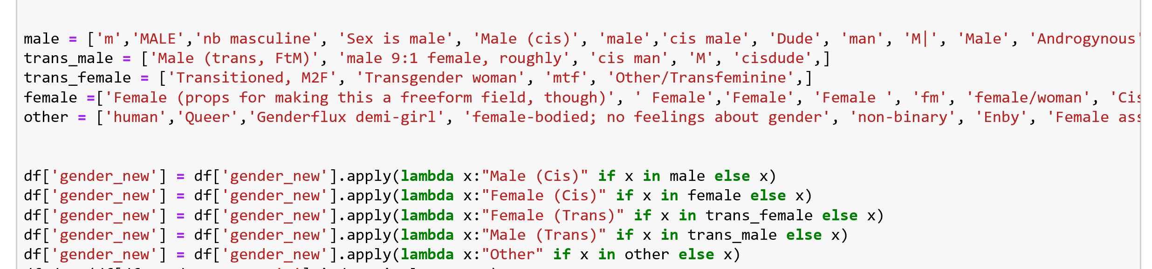
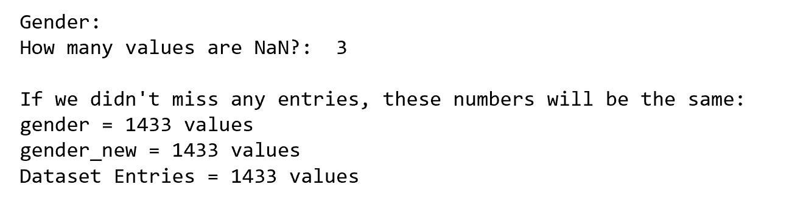
Data Cleaning
Reassignment of data into 5 categories

Slide 20
Normalization and Standardization

Slide 21
What is Normalization and why is it important
Normalization is a technique often applied as part of data preparation for machine learning and data mining projects.
The goal of normalization is to change the values of numeric columns in the dataset to a common scale, without distorting differences in the ranges of values.
Every dataset does not require normalization. It is required only when features have different ranges.
Why is normalization important?
Normalization gives ‘equal’ considerations for each feature.

Slide 22
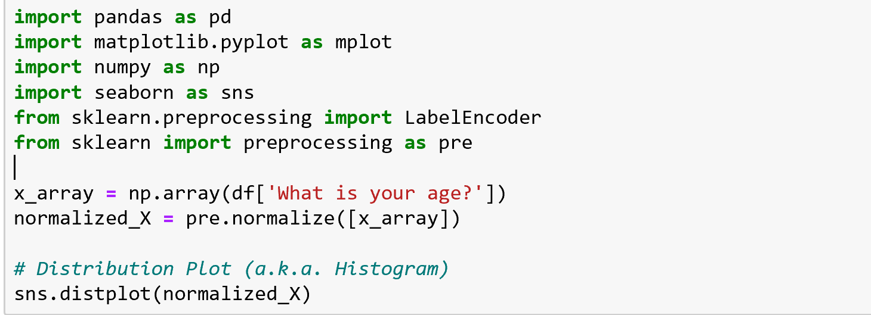
Normalization

Slide 23
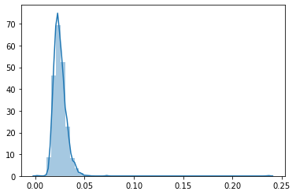
Normal Probability Plot
After Normalization

Slide 24
Two Content Layout with Table
First bullet point here
Second bullet point here
Third bullet point here
Class | Group A | Group B
Class 1 | 82 | 95
Class 2 | 76 | 88
Class 3 | 84 | 90

Slide 25
Data Visualization

Slide 26
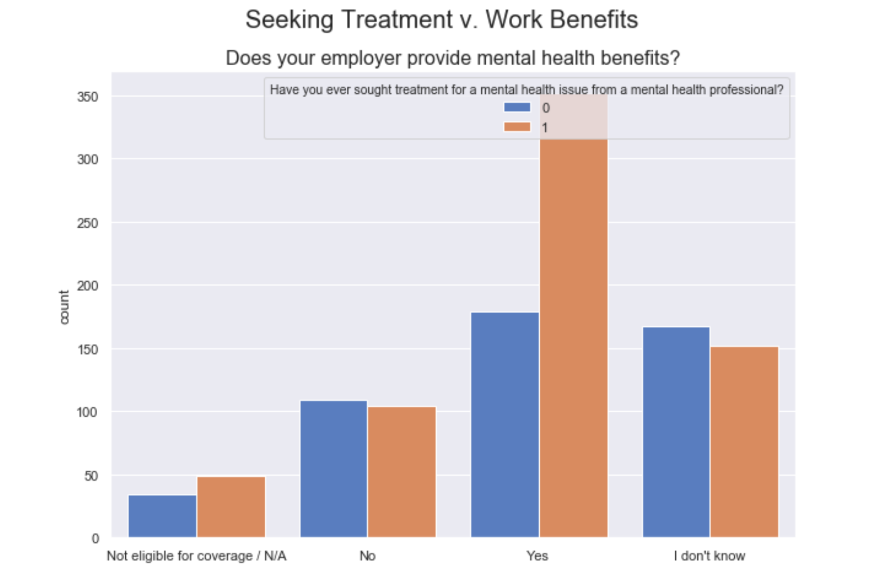
Data Visualization

Slide 27
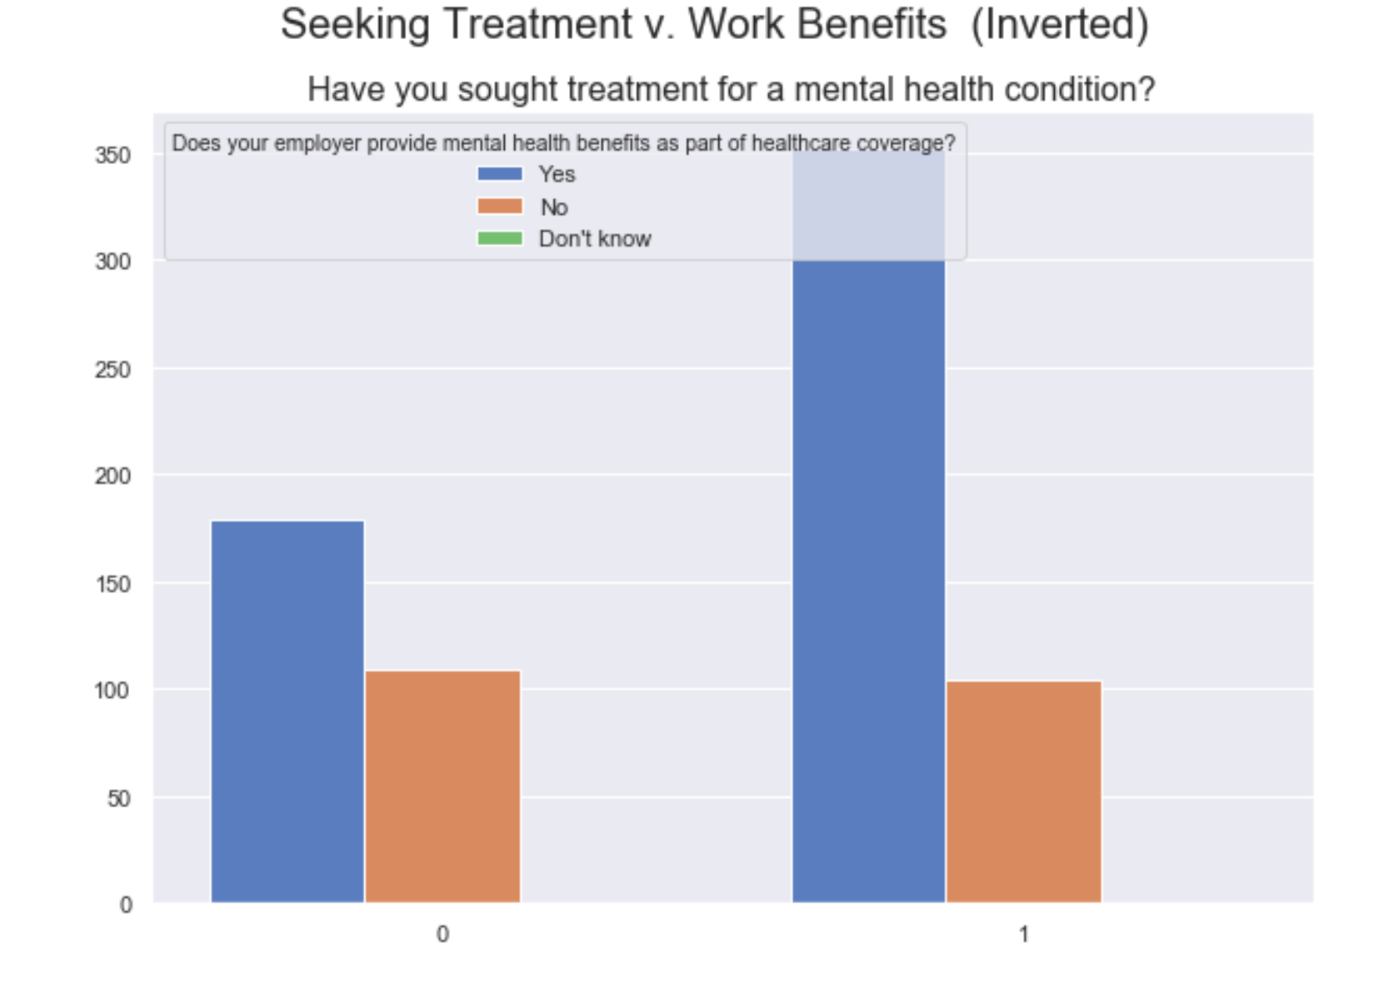
Data Visualization

Slide 28
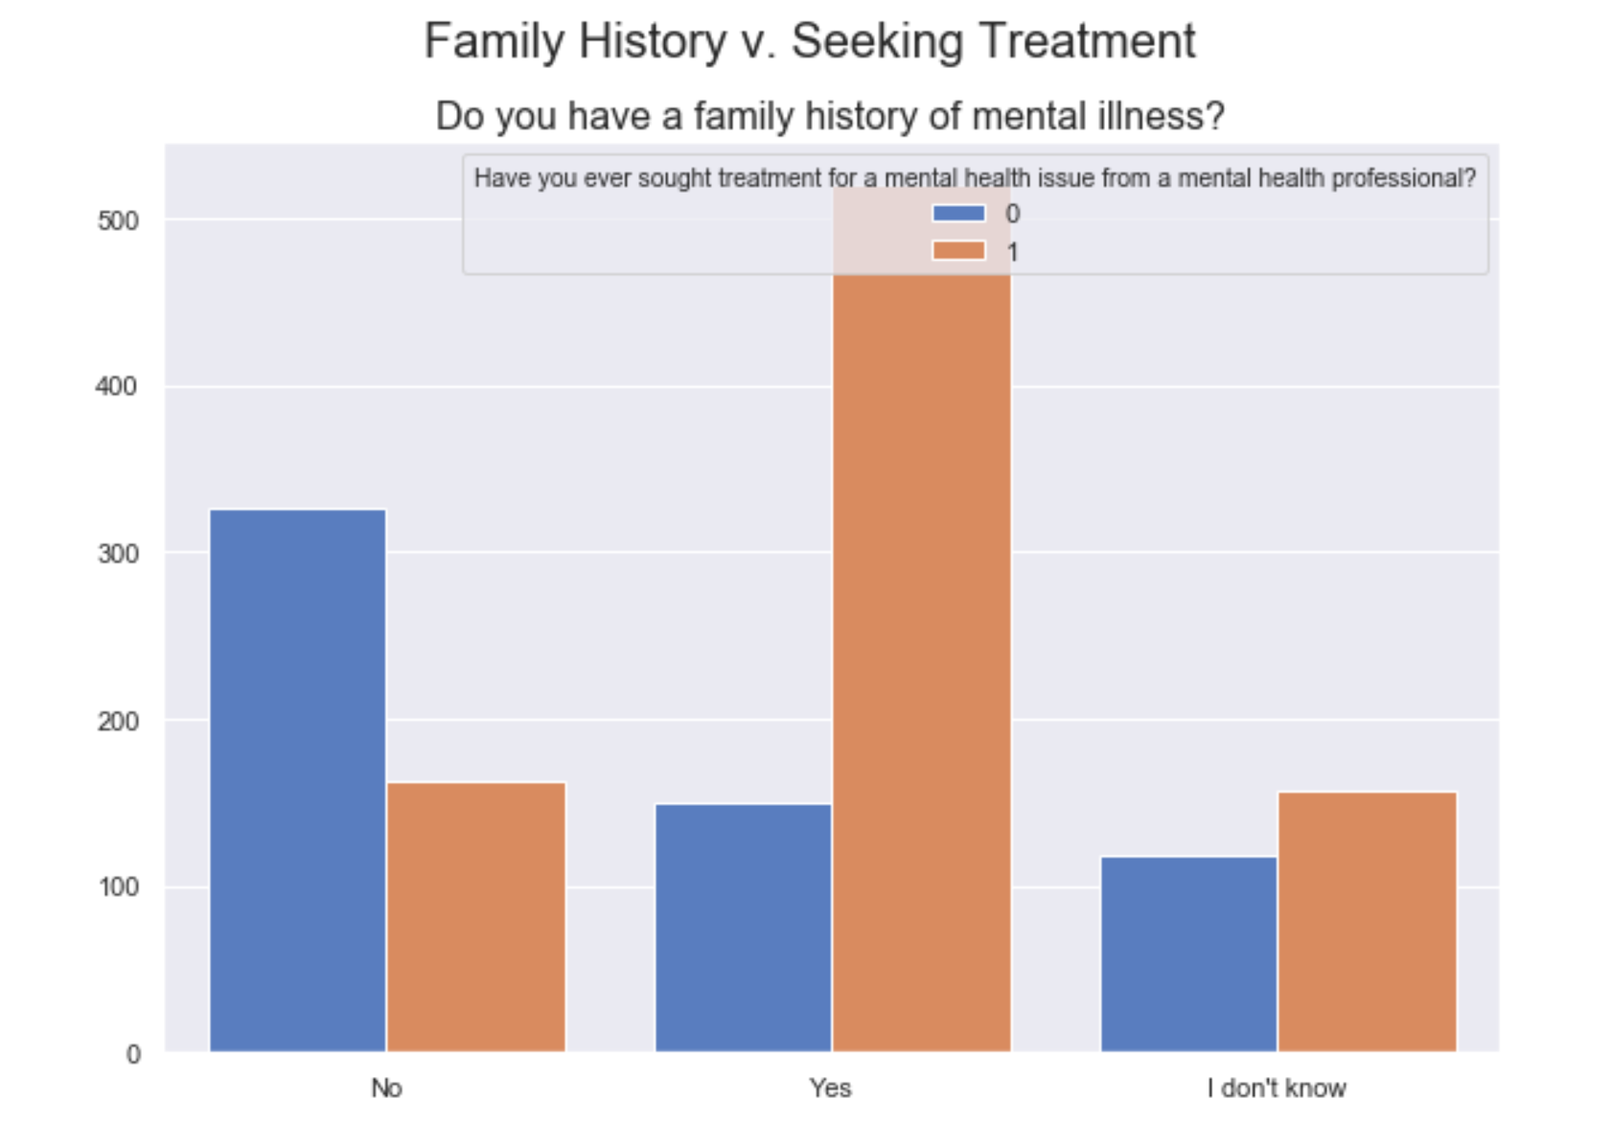
Data Visualization

Slide 29
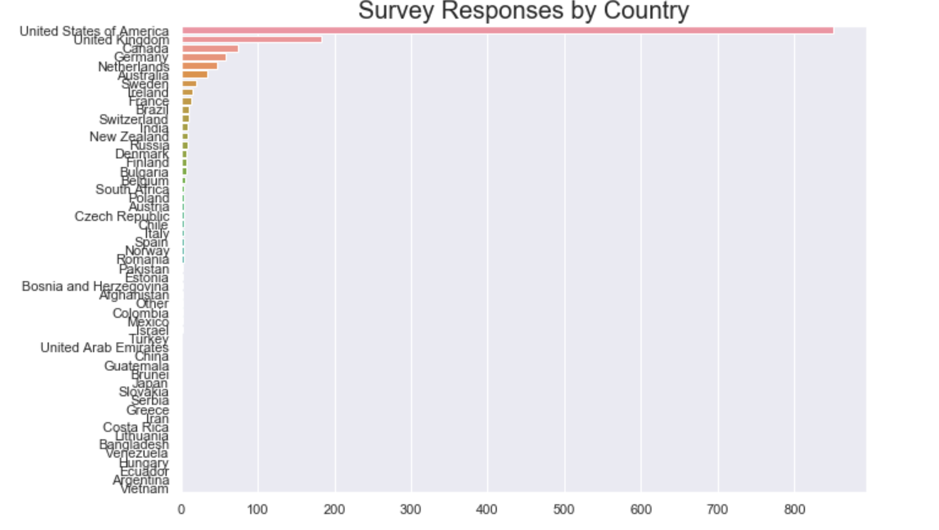
Data Visualization

Slide 30
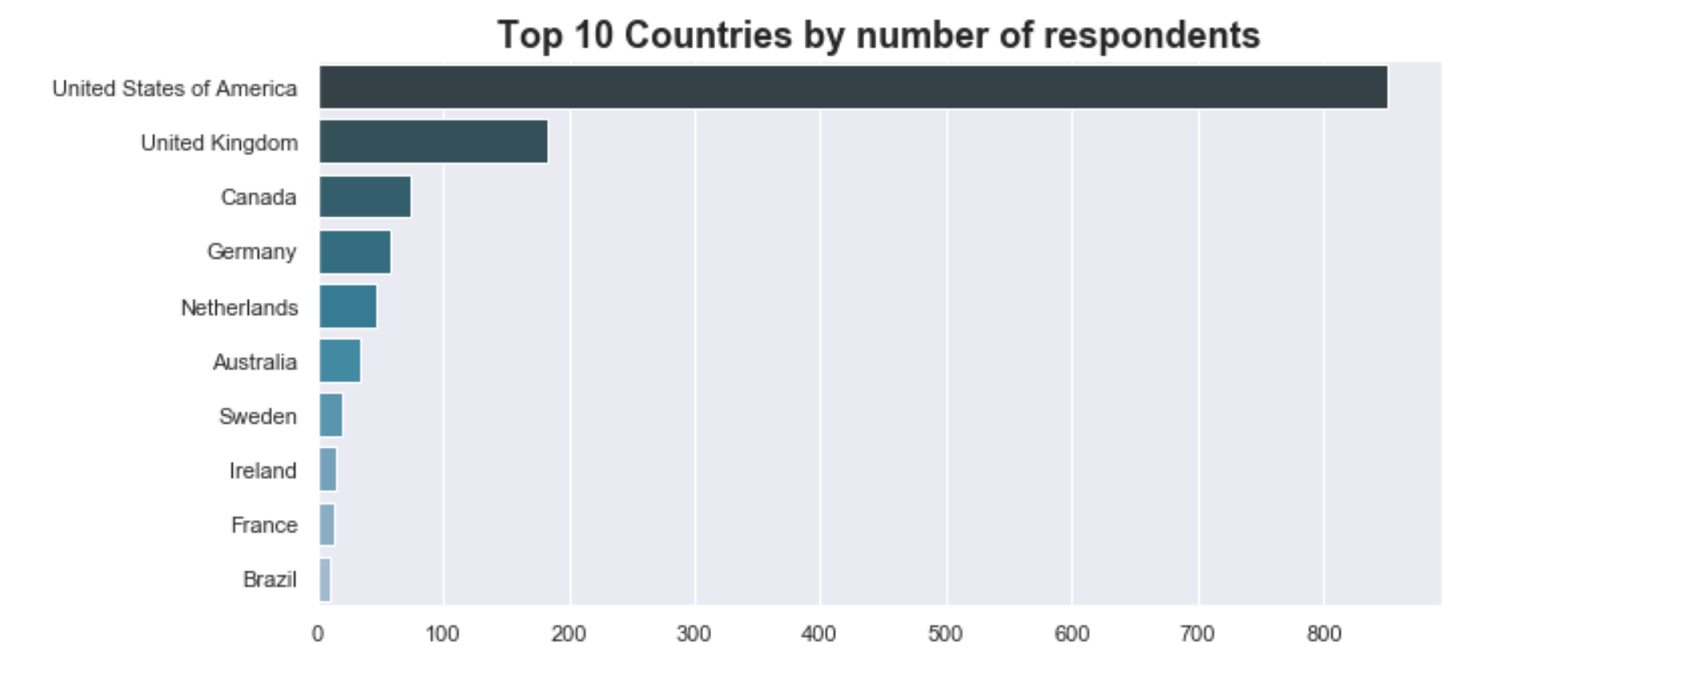
Data Visualization

Slide 31
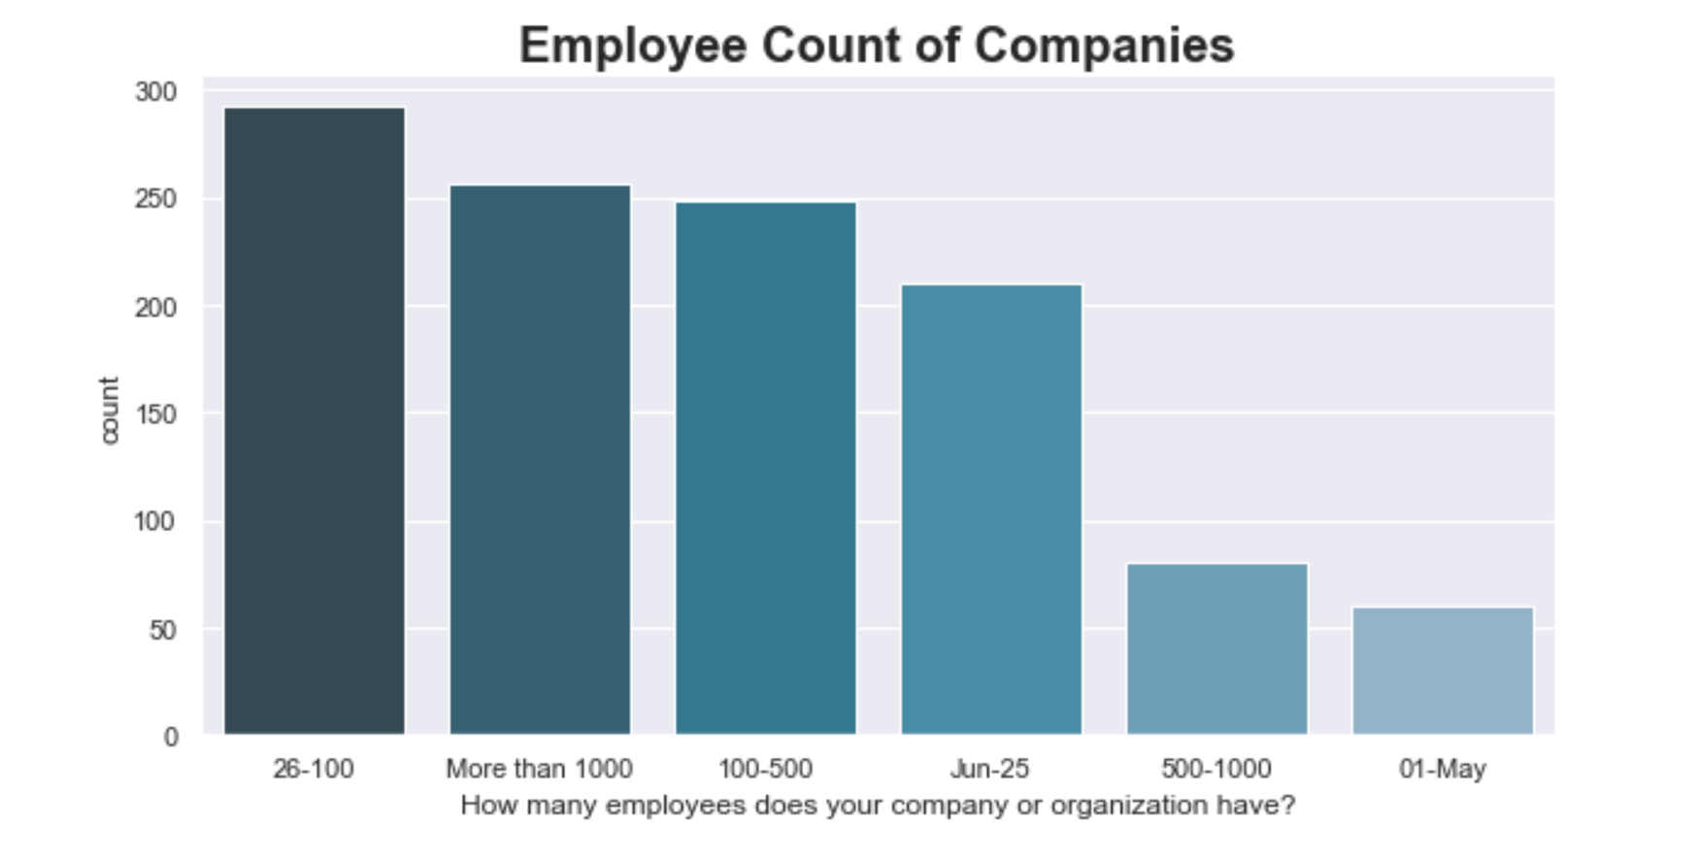
Data Visualization

Slide 32
Correlation

Slide 33
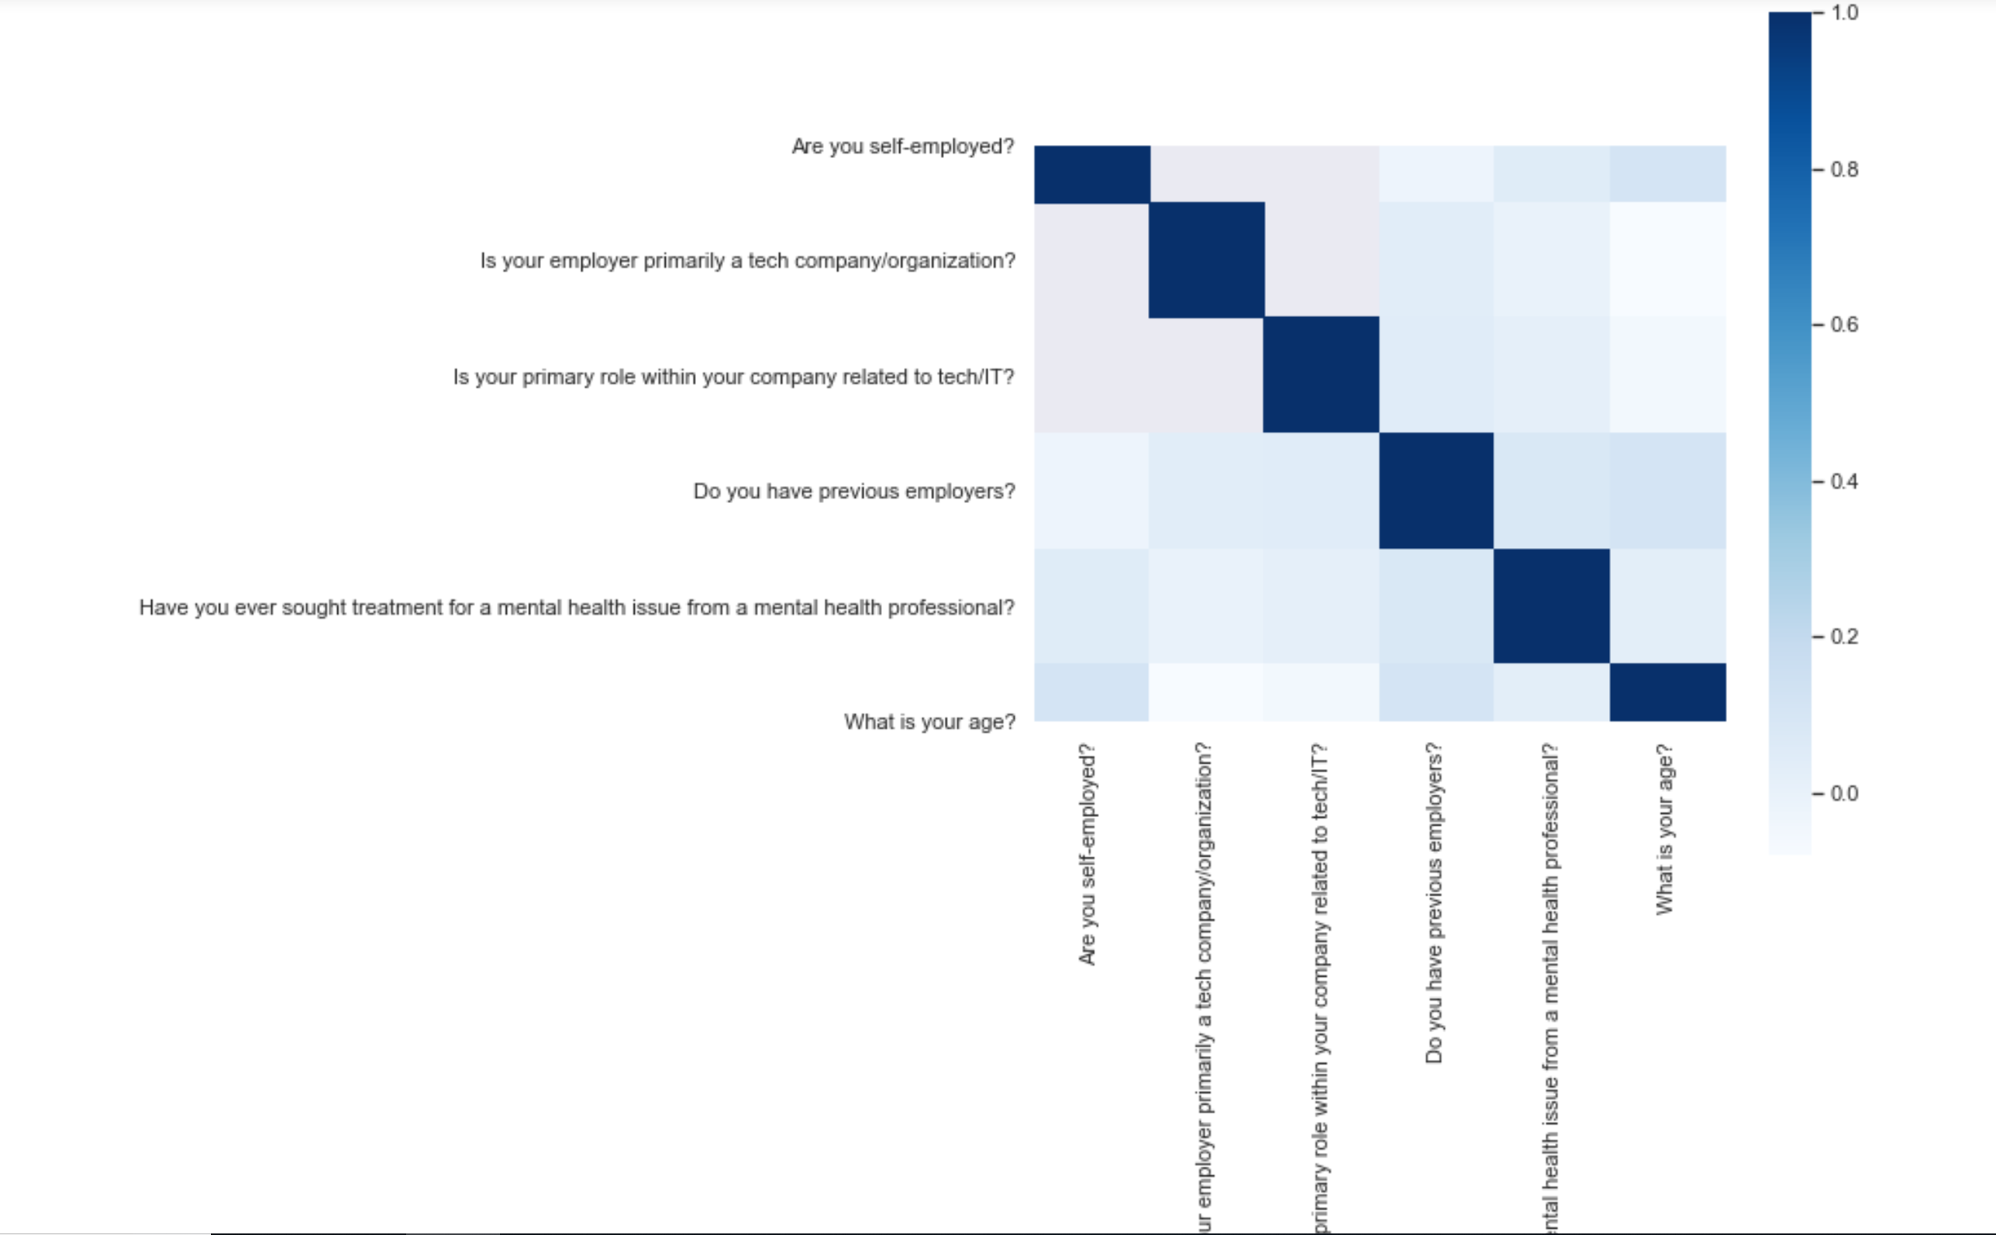
Correlation

Slide 34
Hypothesis Testing

